Slide 1
North Carolina Growth (Project 1)
Jessica Allard, Alexander Brown, Jasmine Garcia, Michael Hargroder

Slide 2
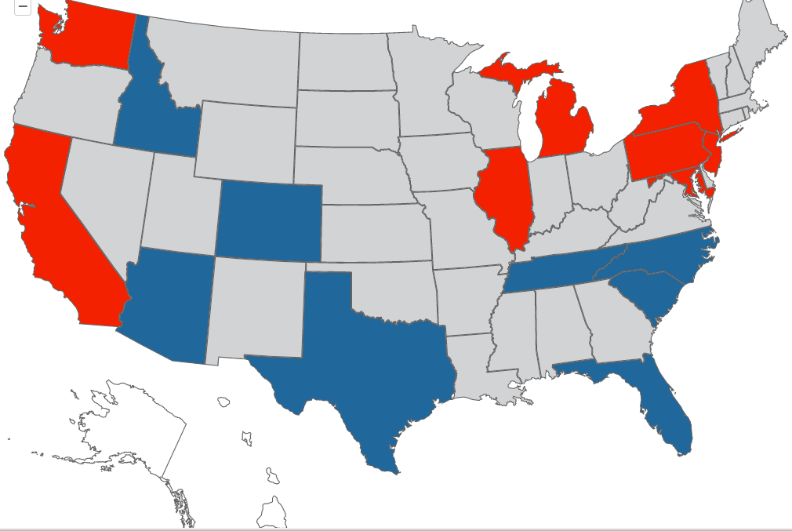

Project Statement
Between the years 2012 and 2018 North Carolina has regularly been identified as a top 5 inbound state by the US Migration Report*. The objective of our analysis is to drill into that fact and explore 2 things:
Given a net positive state inflow, has growth in NC counties been generally uniform OR have some counties/areas experienced significantly more growth? Test hypothesis that growth is limited to already densely populated areas.
2. For counties identified where strong inflow is identified through analysis, has the profile of these counties changed? To answer this question with balance we choose to analyze data through three lenses: Political , Economical & School Enrollment.
* A summary and interactive map of the US Migration Report can be found at: https://www.northamerican.com/migration-map

Slide 3
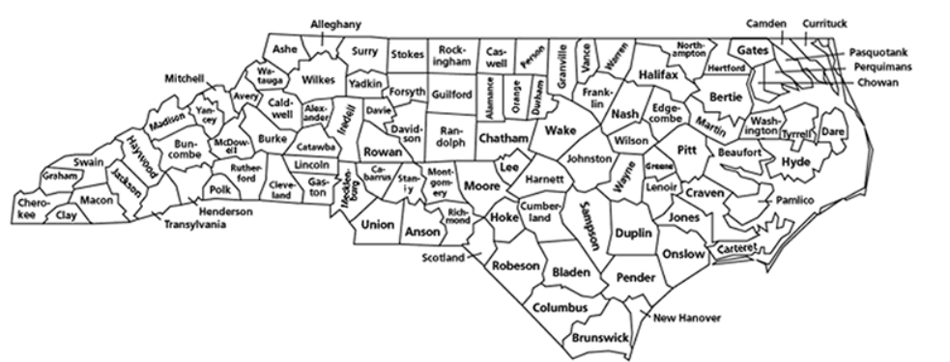
Part 1 – Identifying Growth Counties
Notes:
Quick Fact – There are exactly 100 counties in NC

Slide 4
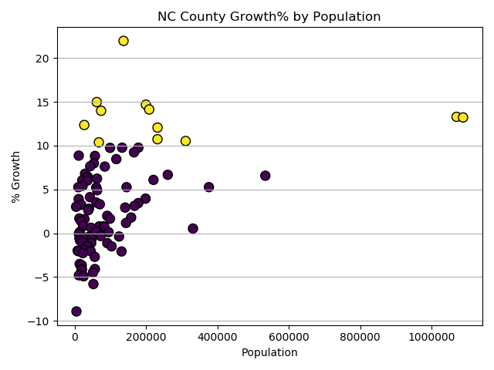
Initial County Plot
Goal:
Determine if there were counties with exceptional growth between 2012 and 2018 on a % basis.
Approach:
Sourced csv file with distinct rows for each county in NC.
Imported csv with Pandas and create basic data frame
Add empty columns to data frame to hold start and end year population as well as geo coordinates.
Using rest API and python loop populate columns population and coordinate columns.
Create calculated column for % change and Boolean column for high growth (> 10)
Used Matplotlib scatter plot to plot data frame
Source Code:
https://github.com/jasgarcia/NCGrowth/blob/master/NC_County_Growth.ipynb

Slide 5
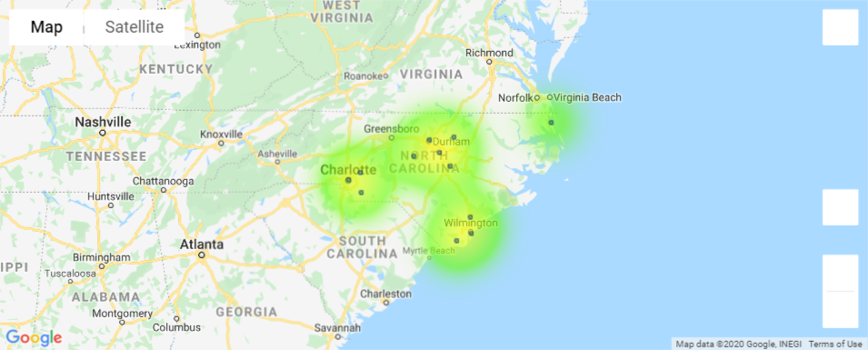
High Growth County Map Plot
Goal:
Use gmaps to plot high growth counties to highlight regional clusters.
Approach:
Created second data frame based on data frame assembled for initial scatter plot. This data frame only contained rows where growth > = 10%.
Created gmaps figure.
Added marker layer
Added heatmap
Source Code:
https://github.com/jasgarcia/NCGrowth/blob/master/NC_County_Growth.ipynb

Slide 6
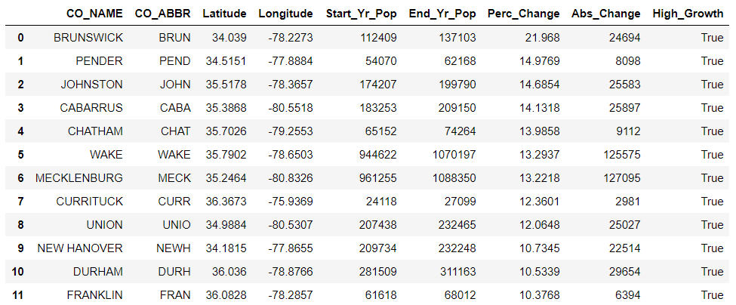
High Growth County Data Frame
Costal counties Brunswick and Pender are leading growth on a % basis..
The most densely populated counties Wake and Mecklenburg have the strongest absolute growth and with near identical rates of change in bot % and absolute terms.

Slide 7



Part 2– High Growth County Profile Trends
Government
Economy
Education
Notes:
Quick Fact – There are exactly 100 counties in NC

Slide 8
Some title
slides for Alex’s political stuff

Slide 9
Some title
slides for Jasmine’s median income stuff

Slide 10
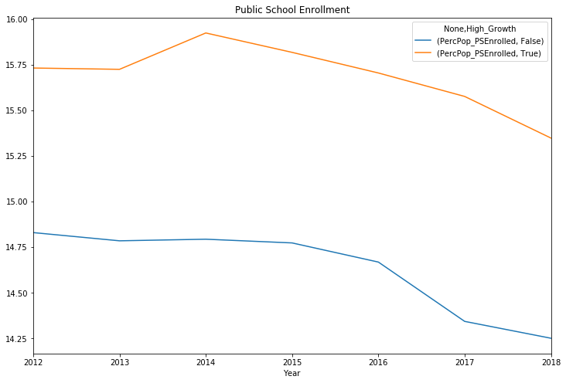
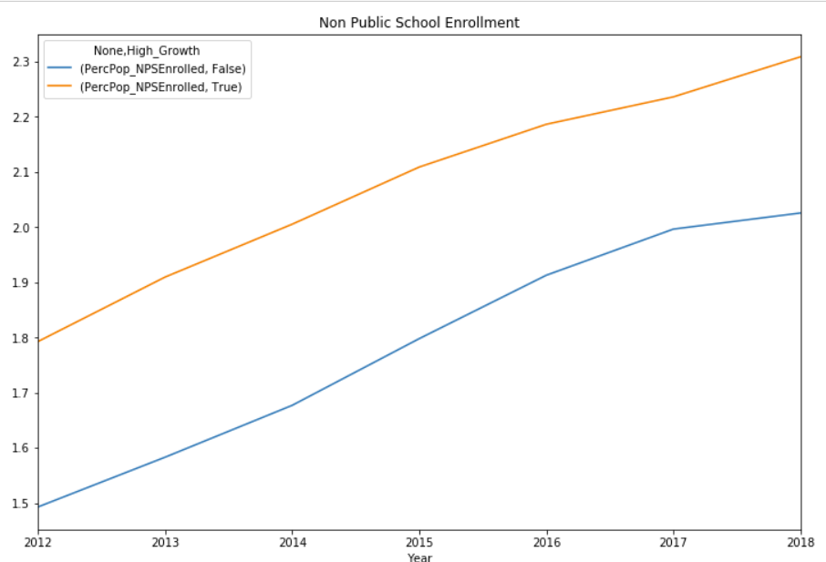
Public / Non Public School Enrollment

Slide 11
Where Next?

Slide 12
Thank You
&
Any Questions
We could put our contact info here….

